Slide 1
Riser System
Presented by:
Sanket Ingole, Junior Control Software Engineer, Aker Solutions
Pune, 24 Jan, 2023

Slide 2
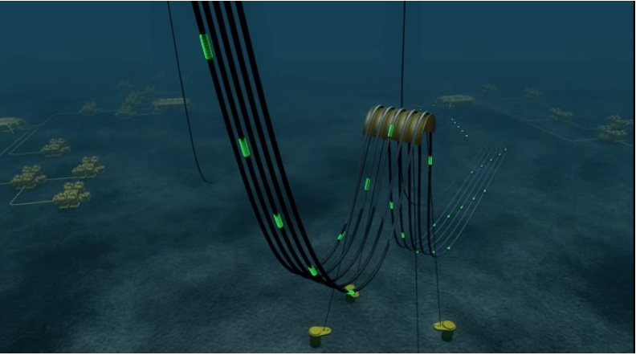
Riser System:
The purpose of the Riser System is to connect the subsea flowlines and umbilicals to the host facility (FPSO/platform).

Slide 3
There are 4 variation in risers based on applications:
1.Production Riser
2.Umbilical Riser
3.Export Riser
4.Service Riser

Slide 4
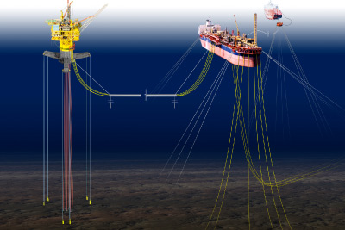
1. Production/Injection Riser:
Production / Injection Riser convey any fluids to/from the various flowlines located on the seabed to the host processing facilities.

Slide 5
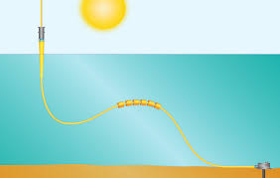
2. Umbilical Riser
The Dynamic Umbilical provides electrical, hydraulic and chemical service lines located on the seabed to the host processing facilities. In some cases gas lift is also included in the umbilical.

Slide 6
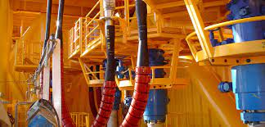
3. Export Riser
The Export Riser conveys processed fluids to an export pipeline.

Slide 7
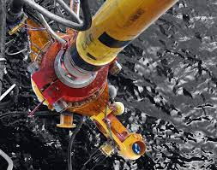
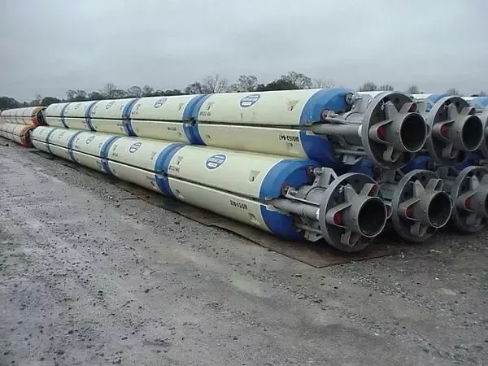
4. Service Riser
The Service Riser's typical functionality is chemical injection, drill cutting injection or support well operations.

Slide 8
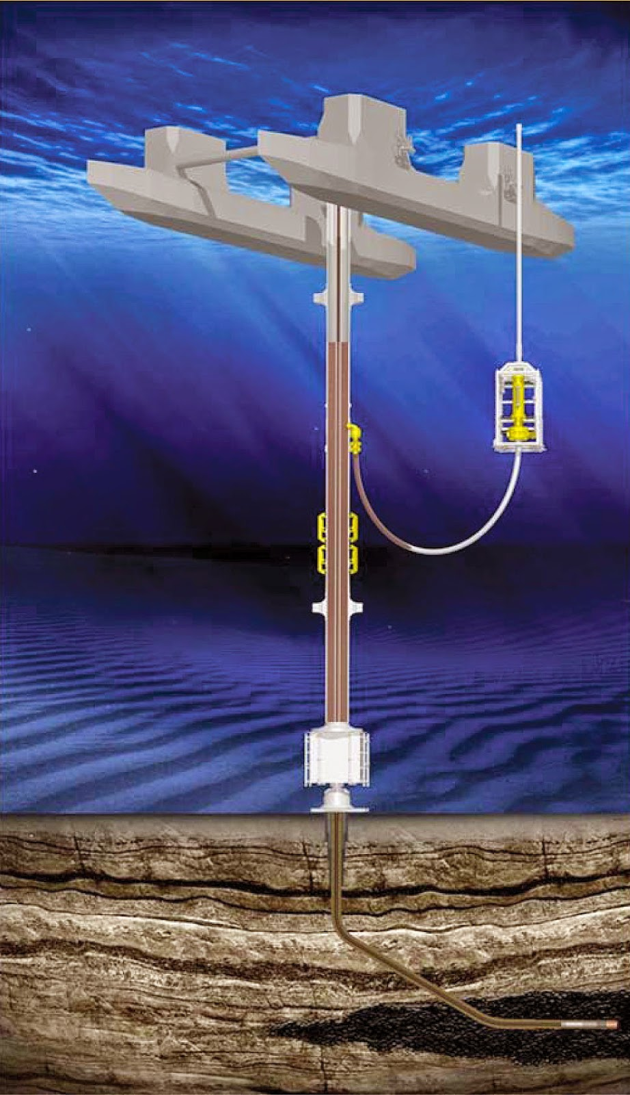
Drilling risers:
These transfer mud to the surface during drilling activities
Connected to the subsea BOP(blowout preventer) stack at the bottom and the rig at the top, drilling risers temporarily connect the well bore to the surface to ensure drilling fluids to not leak into the water.
Drilling risers can be used upto 3000m depth.

Slide 9
Riser Solution:
1. Flexible Riser System:
2. Rigid Riser System:
3. Steel Riser System:

Slide 10
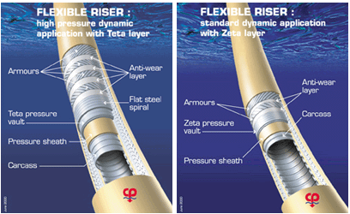
Flexible Riser System
A flexible riser has a small bending stiffness, much less than a steel pipe with the same dimension.
Its dynamic abilities make a flexible riser ideally suitable for use with floating vessels and semi-submersibles.
Flexible risers are used to transport produced fluids from the seabed to surface vessels or platforms, or to transfer injection fluids, control fluids or lift gas from the surface facilities to the seabed.
Its flexibility and strength is assured by a carefully designed assembly of alternate layers of metallic and thermoplastic materials.
Ex. Mostly, It is used with Semi-submersibles, FPSO

Slide 11
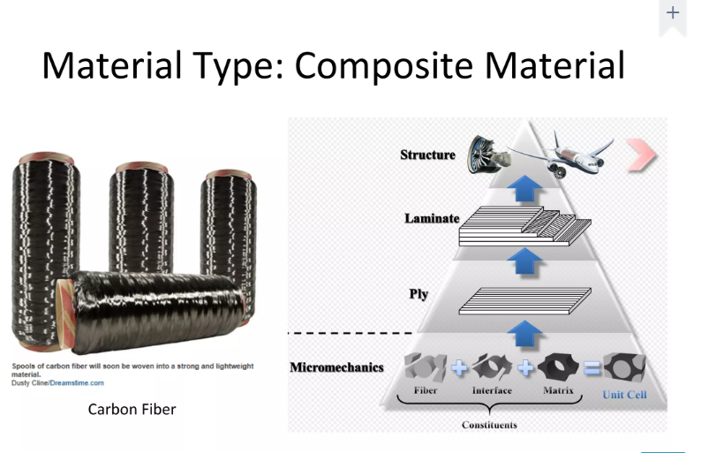

Slide 12
Rigid Riser System
On fixed, bottom-founded host structures, the production risers are typically rigid steel pipes which are attached at various points/water depths to the structure.
Alternatively, J-tubes and I-tubes preinstalled on fixed structures can provide a rigid conduit.
Ex. It is used with Conventional fixed platform, Compliant tower, Vertically moored tension leg and mini tension leg platform, Spars

Slide 13
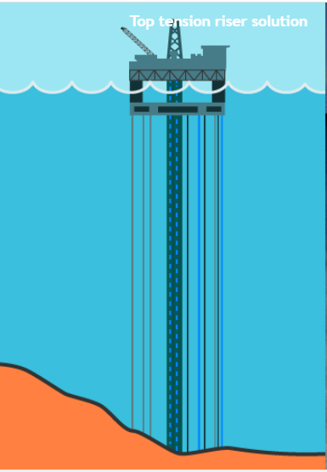
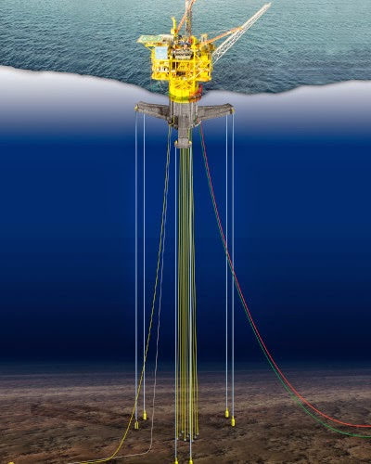
Steel Riser System
In vertically moored host structures a steel riser system can be applied.
In shallow water (typ. down to 350m) top tension riser may be used.

Slide 14
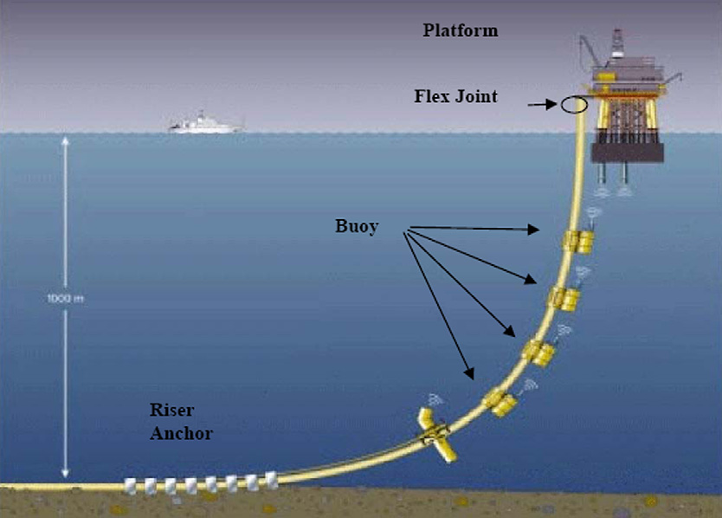
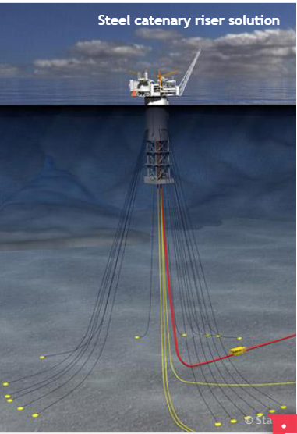
In deeper water steel catenary riser(SCR) is used.

Slide 15
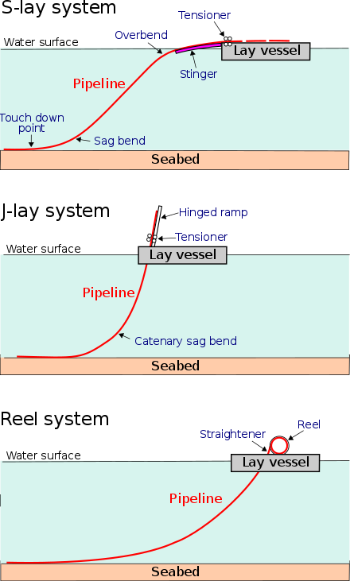
Riser Styles:
The Risers can be installed in three different ways depending on the flowline system solution that is chosen.

Slide 16
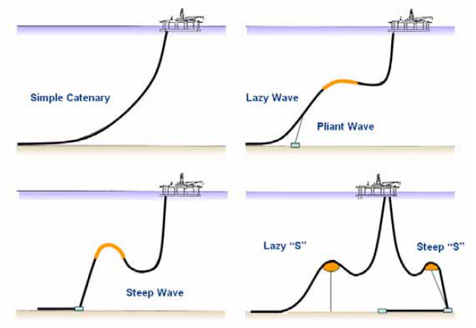
Lazy Wave and Steep wave
Lazy ‘S’ and Steep ‘S’

Slide 17
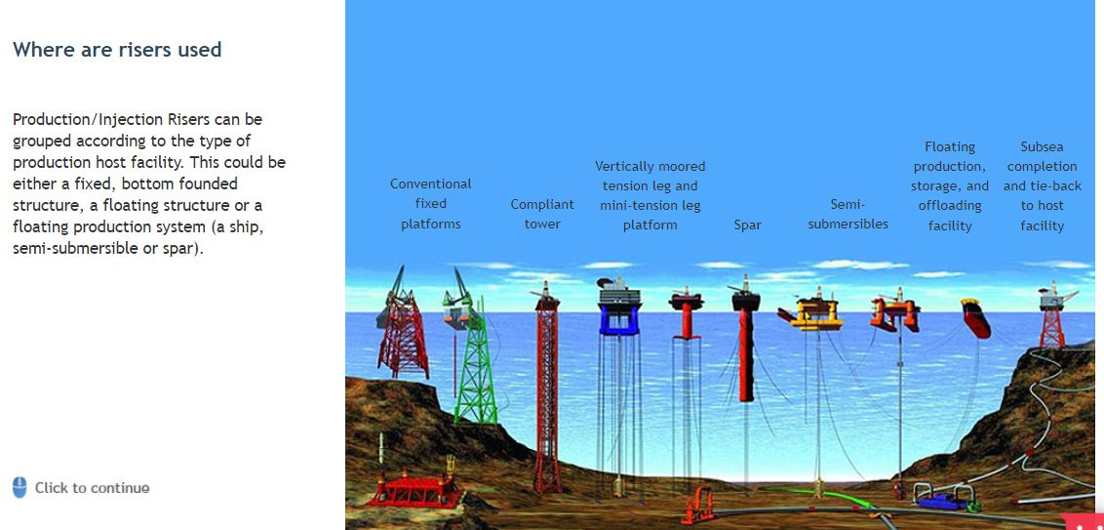
Can you find the flexible risers from below picture?

Slide 18
Thank You!

Slide 19
Copyright and Disclaimer
Copyright Copyright of all published material including photographs, drawings and images in this document remains vested in Aker Solutions and third party contributors as appropriate. Accordingly, neither the whole nor any part of this document shall be reproduced in any form nor used in any manner without express prior permission and applicable acknowledgements. No trademark, copyright or other notice shall be altered or removed from any reproduction.
Disclaimer This Presentation includes and is based, inter alia, on forward-looking information and statements that are subject to risks and uncertainties that could cause actual results to differ. These statements and this Presentation are based on current expectations, estimates and projections about global economic conditions, the economic conditions of the regions and industries that are major markets for Aker Solutions ASA and Aker Solutions ASA’s (including subsidiaries and affiliates) lines of business. These expectations, estimates and projections are generally identifiable by statements containing words such as “expects”, “believes”, “estimates” or similar expressions. Important factors that could cause actual results to differ materially from those expectations include, among others, economic and market conditions in the geographic areas and industries that are or will be major markets for Aker Solutions’ businesses, oil prices, market acceptance of new products and services, changes in governmental regulations, interest rates, fluctuations in currency exchange rates and such other factors as may be discussed from time to time in the Presentation. Although Aker Solutions ASA believes that its expectations and the Presentation are based upon reasonable assumptions, it can give no assurance that those expectations will be achieved or that the actual results will be as set out in the Presentation. Aker Solutions ASA is making no representation or warranty, expressed or implied, as to the accuracy, reliability or completeness of the Presentation, and neither Aker Solutions ASA nor any of its directors, officers or employees will have any liability to you or any other persons resulting from your use.
Aker Solutions consists of many legally independent entities, constituting their own separate identities. Aker Solutions is used as the common brand or trade mark for most of these entities. In this presentation we may sometimes use “Aker Solutions”, “we” or “us” when we refer to Aker Solutions companies in general or where no useful purpose is served by identifying any particular Aker Solutions company.

